Slide 1
SPECIAL TOPICS
Inside The Numbers
STATISTICS ON THE WORK WE DO

Slide 2
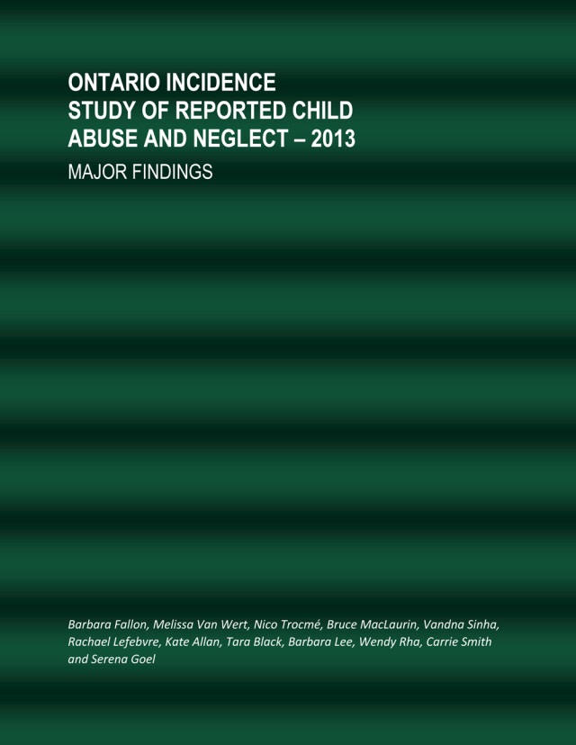
What is the best source?
Ontario Incidence of Reported Child Abuse and Neglect 2013.
Published 2015

Slide 3
WHAT PEOPLE BELIEVE
Most investigations by a Children’s Aid Society find that children are being abused.
THE REALITY
Nearly 40 percent of investigations are deemed to be Unfounded.

Slide 4
TOTAL NUMBER OF INVESTIGATIONS
125,281
Or 53 per 1,000 children

Slide 5
WHAT PEOPLE BELIEVE
Most of the kids seen by a Children’s Aid Society are taken out of their homes and placed into foster care.
THE REALITY
The vast majority of kids seen by a Children’s Aid Society stay in their homes with their families.

Slide 6
97%
Even with other entry points – about 90% of the kids we see stay in their homes

Slide 7
WHAT PEOPLE BELIEVE
Most of the work a Children’s Aid Society does revolves around sexual and physical abuse of children.
THE REALITY
Sexual and physical abuse is just a fraction of the work Children’s Aid Societies do.

Slide 8
PHYSICAL HARM
None: 95%
Harm, no treatment required: 4%
Harm, treatment required: 1%
EMOTIONAL HARM
None: 65%
Harm, no treatment required: 13%
Harm, treatment required: 22%

Slide 9
WHAT PEOPLE BELIEVE
Most of the children that a Children’s Aid Society see who have been abused or neglected have mental health problems.
THE REALITY
There are a variety of issues that children face once they have been exposed to abuse or neglect. Some children have multiple issues, some have none.

Slide 10
Only in substantiated cases and at time of investigation.

Slide 11
WHAT PEOPLE BELIEVE
Parents of children who have been abused or neglected are just bad people.
THE REALITY
The challenges that these caregivers face are complex and involve a variety of different and sometimes related issues.

Slide 12
Covers primary caregivers of children in substantiated cases of maltreatment and at time of investigation.

Slide 13
Find Out More
www.FamilyandChildren.ca

